Slide 1
Multiscale Image Analysis and Applications
By Brady Sheehan, Duquesne University
Advised by Stacey Levine, Ph.D.
April 10th, 2015

Slide 2
Outline
Motivation
Mathematical Model
Filtering an Image
Scale Space
Application
Further Study

Slide 3
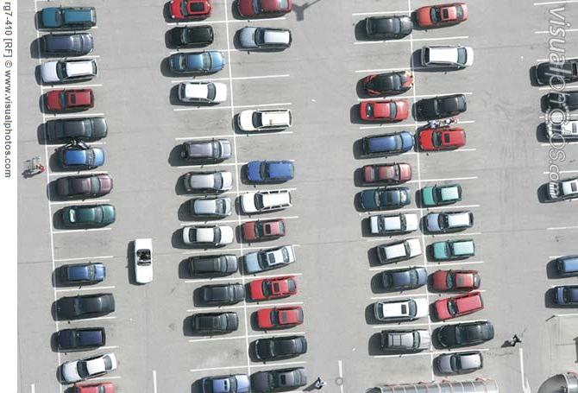
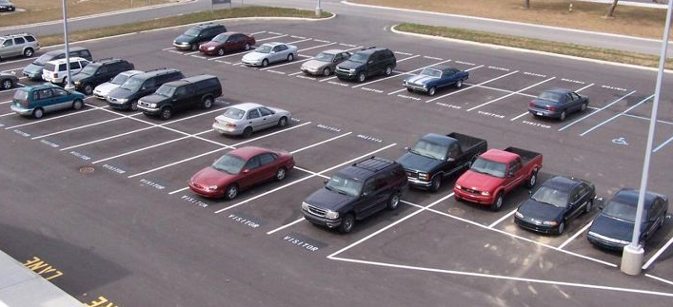
Motivation: A fun problem
Images credit: http://www.techprosecurity.com/security-articles/cctv-security-surveillance-articles/parking-lot-cameras/ and www.sfexaminer.com

Slide 4
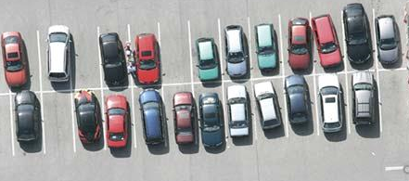
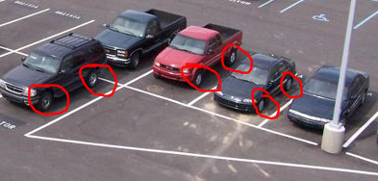
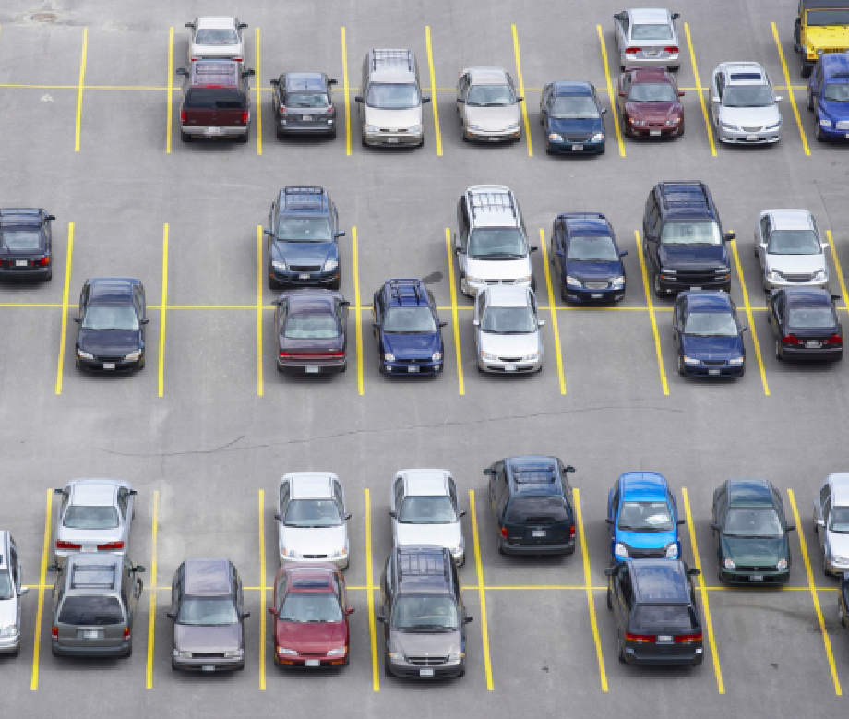
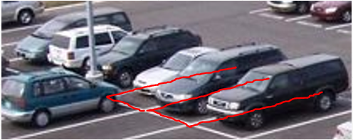
Motivation: A fun problem

Slide 5
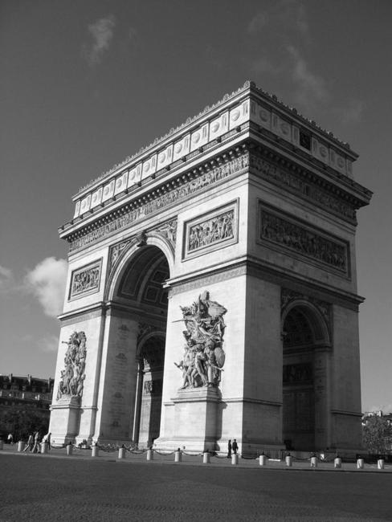
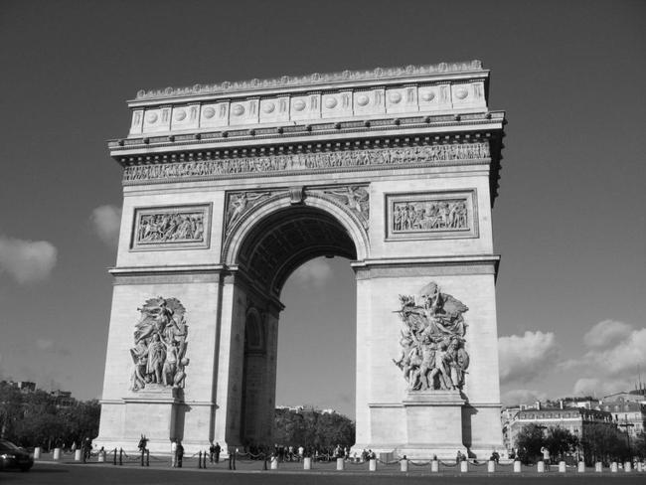
Motivation: Image Matching
Images credit Image Processing Online: http://demo.ipol.im/demo/82/

Slide 6
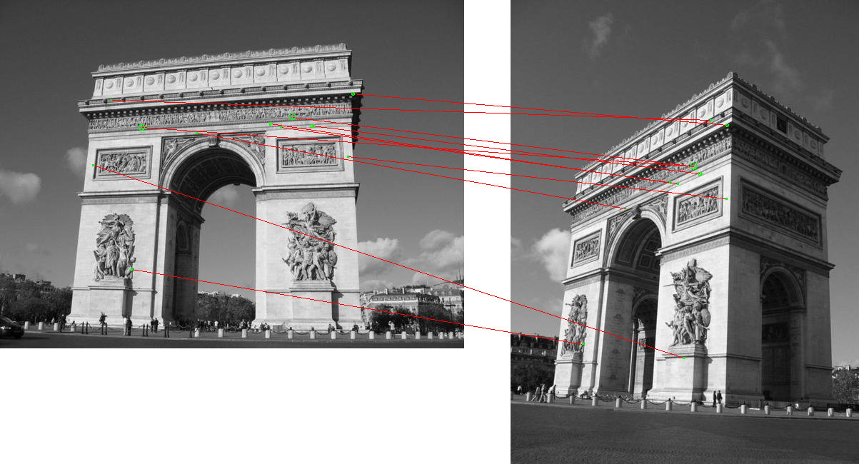
Scale Invariant Feature Transform (SIFT)
Algorithm that extracts a set of descriptors from an image
Descriptors are invariant to image translation, rotation, and scaling
Descriptors can be used for matching pairs of images
Algorithm’s effectiveness comes from computing a multiscale representation of the images, called a scale space
Scale: the size of objects and content within the image
Resolution: number of pixels in an image

Slide 7
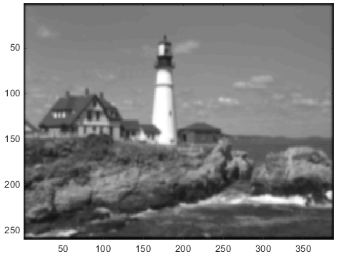
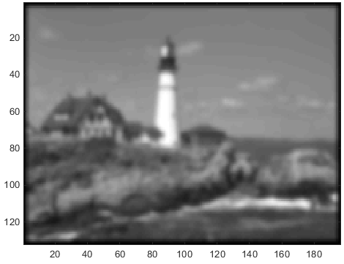
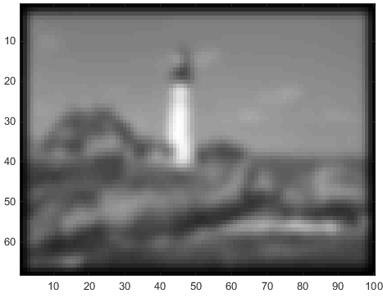
Scale Space: Example
small features large features
fine detail course detail
high res. low res.
scale
resolution

Slide 8
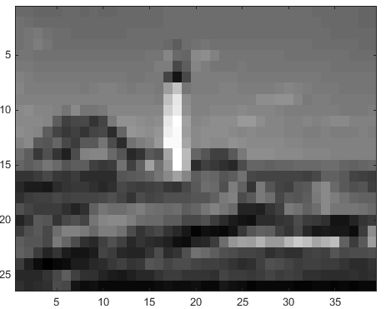
Representing an Image
An image can be represented as a function of two variables $f\left(x,y\right)=I$
where $x$ and $y$ are spatial coordinates in an image and $I$returns the intensity of the image at that spatial location
An image can also be represented as a matrix with entries ranging from 0 as black to 255 as white

Slide 9
How do we apply a filter?
Convolution in the spatial domain
Applying a filter to an image $f$ of size $M x N$with a filter $w$ of size $m x n$can be expressed as
$w\left(x,y\right)∗I= \sum_{s=−a}^{a}{\sum_{t=−b}^{b}{w\left(s,t\right)f(x+s, y+t)}}$,
for all pixels ($x=1, 2, 3, …, M−1$ and $y=1, 2, 3, …, N−1$),
where $a=\frac{m−1}{2}$ and $b=\frac{n−1}{2}$
Let $G_{σ}∗I$ be convolution of a Gaussian
filter with standard deviation $σ$ over an
image $I$
$$w\left(−1,−1\right)$$ | $$\text{w}\left(−1,0\right)$$ | $$w\left(−1,1\right)$$
$$\text{w}\left(0, −1\right)$$ | $$w\left(0, 0\right)$$ | $$w\left(0,1\right)$$
$$w\left(1,−1\right)$$ | $$\text{w}\left(1,0\right)$$ | $$w\left(1,1\right)$$
 | $$f\left(x,−1 y−1\right)$$ | $$f\left(x−1, y\right)$$ | $$f\left(x−1, y+1\right)$$
 | $$f\left(x, y−1\right)$$ | $$f\left(x, y\right)$$ | $$f\left(x, y+1\right)$$
 | $$f\left(x+1, y−1\right)$$ | $$f\left(x+1, y\right)$$ | $$f\left(x+1, y+1\right)$$

Slide 10
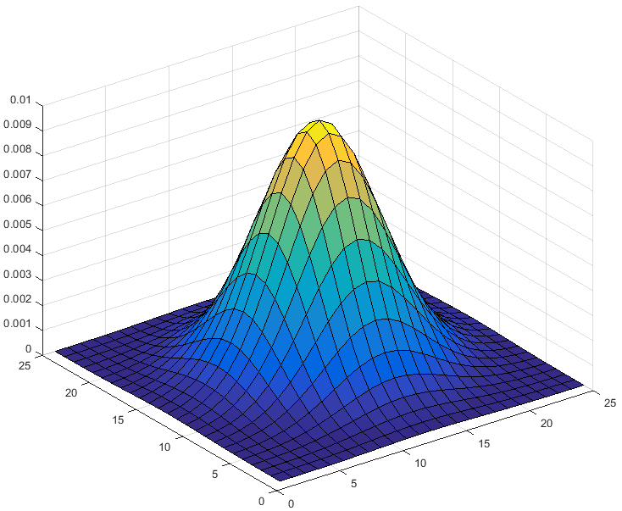
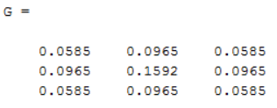
Filter: Gaussian
Most common smoothing filter
$G_{σ}(x,y)=\frac{1}{\sqrt{2πσ^{2}}}exp\left(−\frac{x^{2}+y^{2}}{2σ^{2}}\right)$
where $x$, $y$ are the coordinates in the mask and $σ$is the standard deviation of the Gaussian.
Subsample the Gaussian to create a filter mask

Slide 11
Filter: Laplacian
Background
By definition of a first order derivative of some $f(x)$ , $\frac{∂f}{∂x}=\lim_{h →0}{\frac{f\left(x + h\right) − f(x)}{h}}$
Assume $h$ is some nonzero constant and instead of approaching zero let it approach $h$,
$\frac{∂f}{∂x}≈\frac{f\left(x + h\right) − f(x)}{h}$
Let $h=1$, first order finite forward difference can be defined as
$\frac{∂f}{∂x}≈f\left(x+1\right)−f(x)$, where the error from the approximation is ignored
Thus the second order partial derivative with respect to $x$ of $I$is
$\frac{∂^{2}f}{∂x^{2}}≈f\left(x+1, y\right)+f(x−1,y)−2f(x,y)$

Slide 12
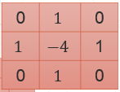
Filter: Laplacian
Laplacian: $∇^{2}f=\frac{∂^{2}f}{∂x^{2}}$ + $\frac{∂^{2}f}{∂y^{2}}$
Since, $\frac{∂^{2}f}{∂x^{2}}=f\left(x+1, y\right)+f\left(x−1,y\right)−2f\left(x,y\right)$,
$∇^{2}f=f\left(x+1, y\right)+f(x−1,y)$ + $f\left(x, y+1\right)+f\left(x,y−1\right)−4f(x,y)$
Mask highlights gray-level discontinuities and deemphasizes regions with slowly varying gray levels
Due to this effect, it can be used for edge detection and enhancement

Slide 13
How do we create a scale space?
Generate one scaled image from an input image $I$ of size $M x N$ and filter mask, $w\left(x,y\right)$, of size $m x n$
$L\left(x,y,σ, l\right)=w\left(x,y\right)∗Iu(l)$, where $u\left(l\right)$ denotes the sampling operator, $l$ denotes resolution change, and $σ$ is scale
Repeat the process with different $σ$ and $l$to generate a scale space
Gaussian scale space is most common because of its properties

Slide 14
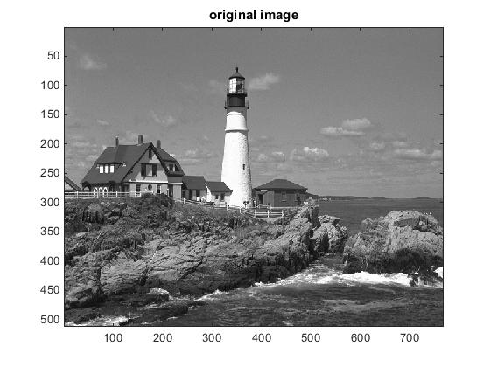
Scale Space: Example Revisited

Slide 15
Scale Space: Example Revisited
Construction of this scale space:
Step 1
Upsample the input image $I$ by $l=2$
Compute some scale, $σ$
Generate an image $I_{l_{2}σ}=G_{σ}∗I$, where${ G}_{σ}(x,y)=\frac{1}{\sqrt{2πσ^{2}}}exp\left(−\frac{x^{2}+y^{2}}{2σ^{2}}\right)$ from the upsampled image
Step 2
Downsample result from step 1 by $l=1/2$ and compute a new scale
Generate $I_{l_{1/2}σ}$
Repeat step 2 three more times using result from previous iteration as input
Algorithm comes from SIFT

Slide 16
Scale Space: Properties
An image $I$ when convolved with a Gaussian filter $G_{σ}$ produces a multiscale representation, $L\left(x,y,σ\right)=S$, that satisfies multiple properties
Linearity
$S\left(aF+bH\right)=aS\left(F\right)+bS\left(H\right)$
where $F$ and $H$ are images while $a$ and $b$ are constants
Shift Invariance
$S\left(g\left(f\right)\right)=g\left(S\left(f\right)\right)$
Where $f$ is an image and $g$ denotes the shift (translation) operator, $g\left(f\right)\left(x,y\right)=f(x− ∆x, y − ∆$y)
Because convolution with a Gaussian filter satisfies these properties, among others, it is an ideal choice for use as a smoothing filter

Slide 17
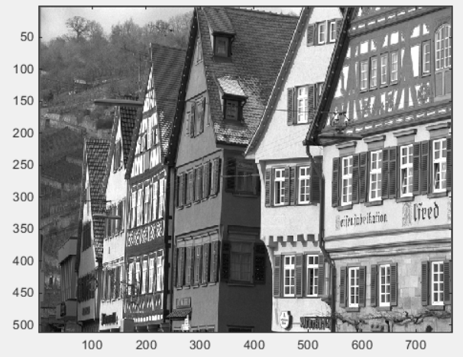
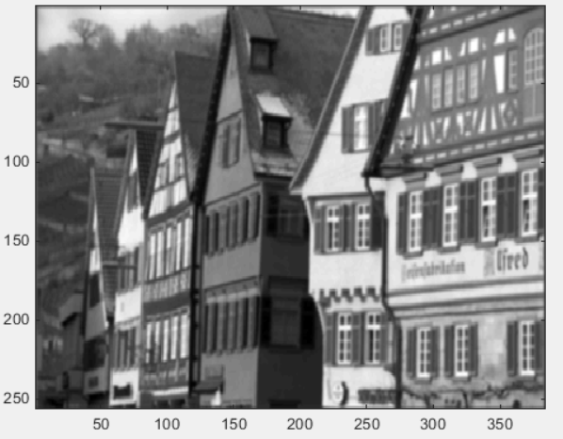
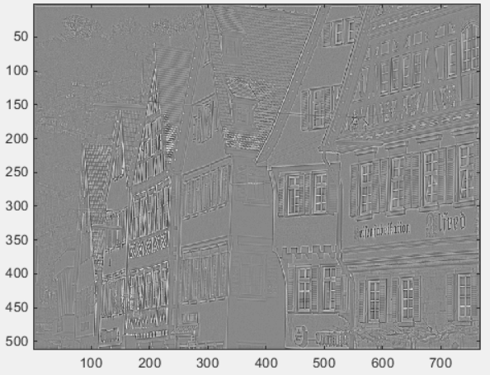
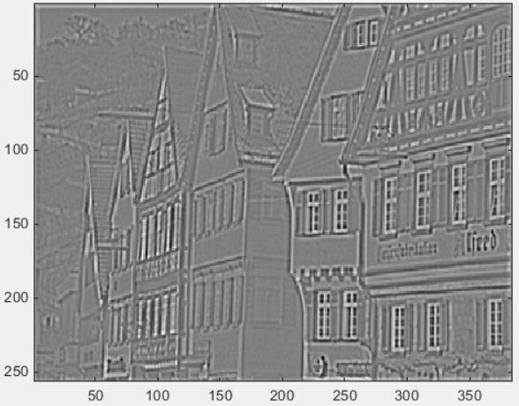
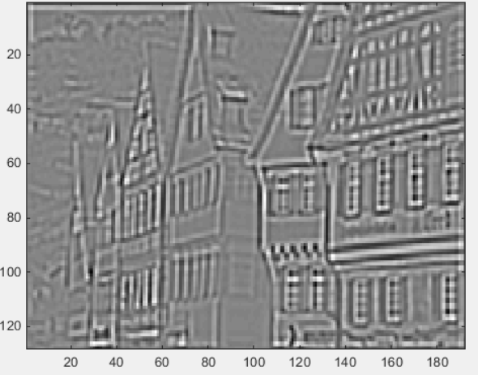
Application: Image Compression
1 | 2 | 1
2 | 4 | 2
1 | 2 | 1
$$\frac{1}{16} \text{x}$$
$${I }_{1}$$
$${I }_{2}$$
$${I }_{3}$$
$${I }_{1}− G_{σ}∗(G_{σ}∗{I }_{1})$$
$${I }_{2}− G_{σ}∗ (G_{σ}∗{I }_{2})$$
$${I }_{3}− G_{σ}∗ (G_{σ}∗{I }_{3})$$
Image credit Kodak Lossless True Color Image Suite: http://r0k.us/graphics/kodak/

Slide 18
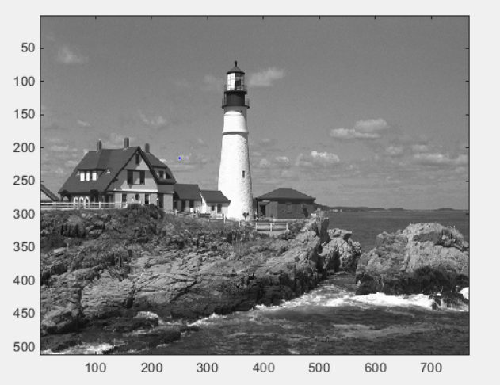
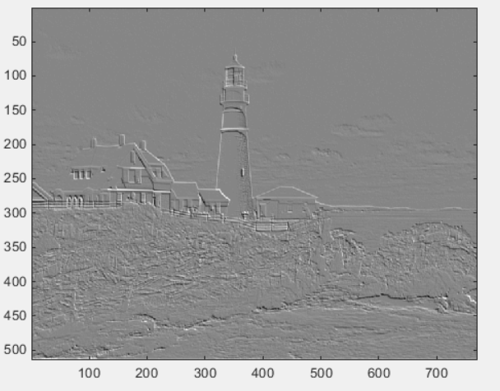
Application: Edge Detection
0 | $$1$$ | 2
$$−1$$ | $$0$$ | 1
$$−2$$ | $$−1$$ | $$0$$

Slide 19
Application: Image Matching

Slide 20
SIFT and Further Study
Understanding the extraction of candidate keypoints
Disregarding unstable keypoints
Defining keypoint reference orientation
Creating the SIFT feature vector
Developing an implementation of these features in MATLAB to use for image matching
Finding a way to apply SIFT or other matching algorithms to original problem of parking lots

Slide 21
References
Gonzalez, Rafael C., and Richard E. Woods. Digital Image Processing. Upper Saddle River, NJ: Prentice Hall, 2002.
Rey-Otero, Ives, and Mauricio Delbracio. "Anatomy of the SIFT Method." Image Processing On Line (2014). Print.

