Slide 1
Geometry in Patch Based Non-Local Denoising Algorithms
By Brady Sheehan, Duquesne University
Advised by Stacey Levine, Ph.D.
April 7th, 2017
Notes:
introduction

Slide 2
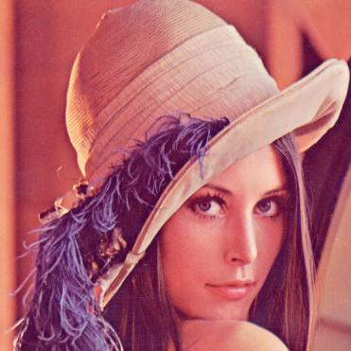
Outline
Motivation
Problem Formulation and Curvature Denoising Framework
Non-local Means Approach and Adaptation
Results and Future Work
“Lenna”

Slide 3
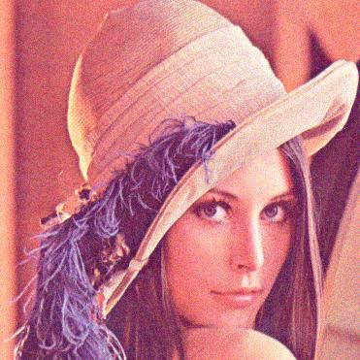
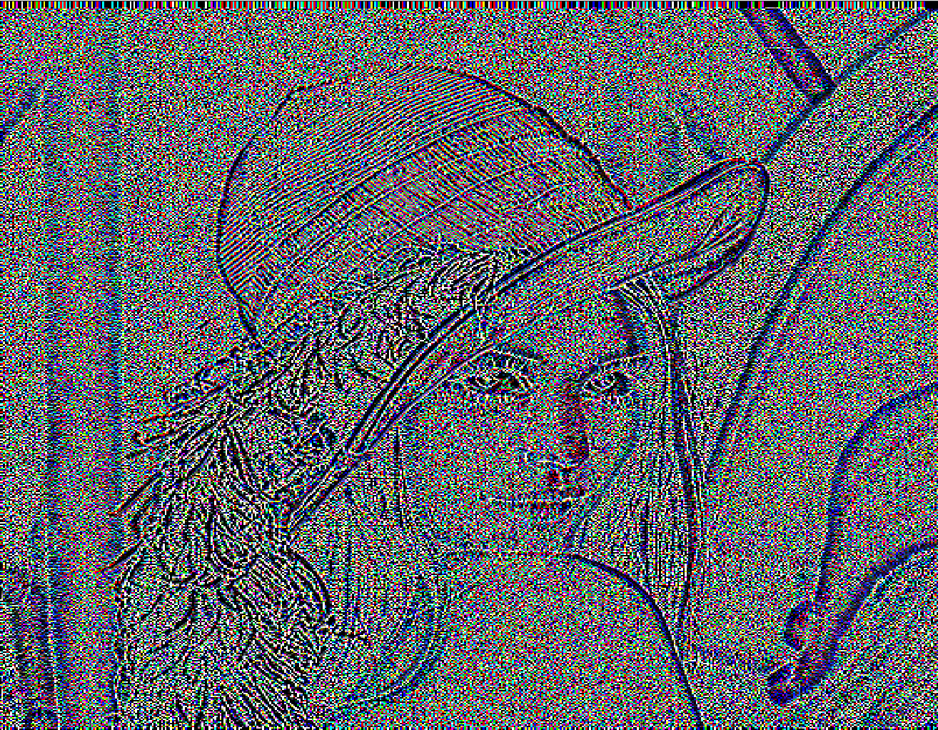
Motivation: Clean Images and Good Geometry
Notes:
On the left you see Lenna, a common photo in the image processing community shown with added Gaussian noise
On the right you see Lenna, after we computed the curvature of her level lines

Slide 4
Motivation: State of the Art Denoising Methods
BM3D is a well-known, state of the art, patched-based denoising algorithm (but it’s not perfect!)
Noisy Image $σ$= 15
Original image
BM3D Result
Images credit: http://r0k.us/graphics/kodak/ Algorithm credit: http://demo.ipol.im/demo/l_bm3d/
Notes:
How well can we currently denoise images?
BM3D is one algorithm in the class of algorithms that approach denoising by considering patches – its good.
It turns out that BM3D is about as close to as good as patch based denoising algorithms can get (in terms of mean square error)

Slide 5
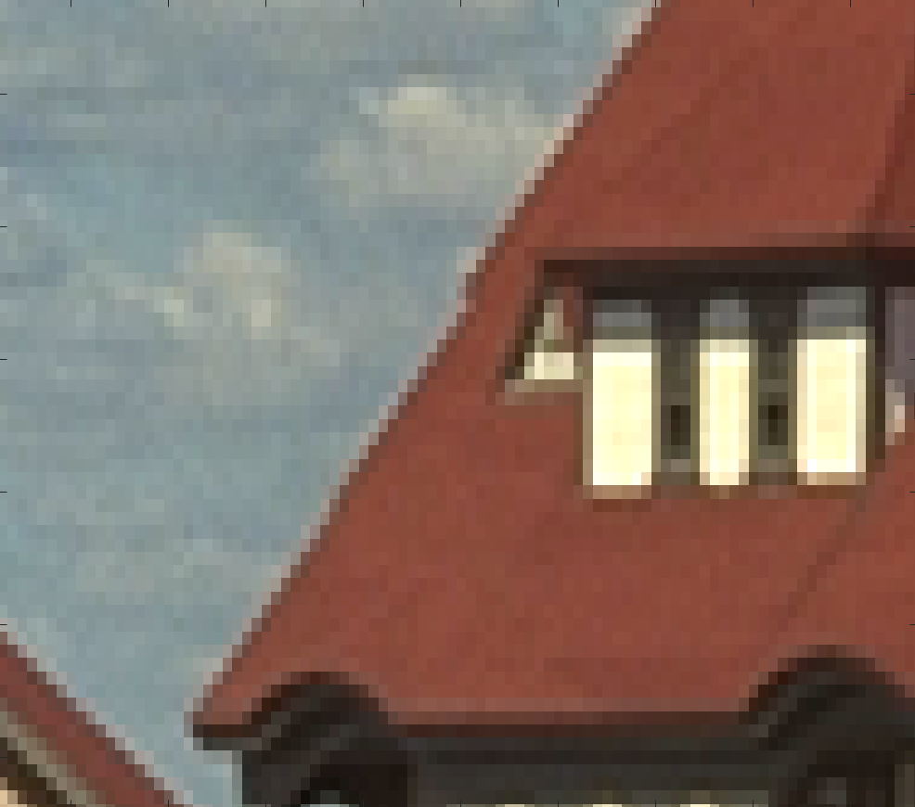
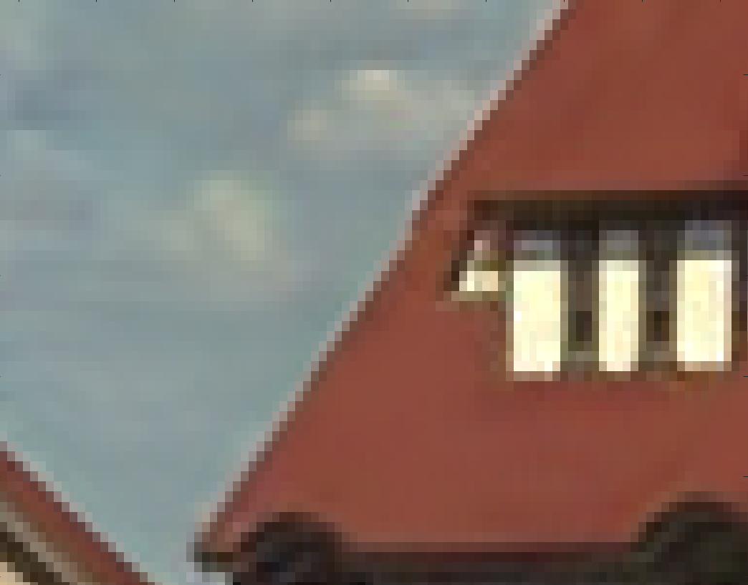
Motivation: State of the Art Denoising Methods
Original image
BM3D Result
Images credit: http://r0k.us/graphics/kodak/ Algorithm credit: http://demo.ipol.im/demo/l_bm3d/
Notes:
Here I blew up one section of the images from the previous slide.
Here you can notice that the image on the right is much smoother than the image on the left:
Clouds, edges, house

Slide 6
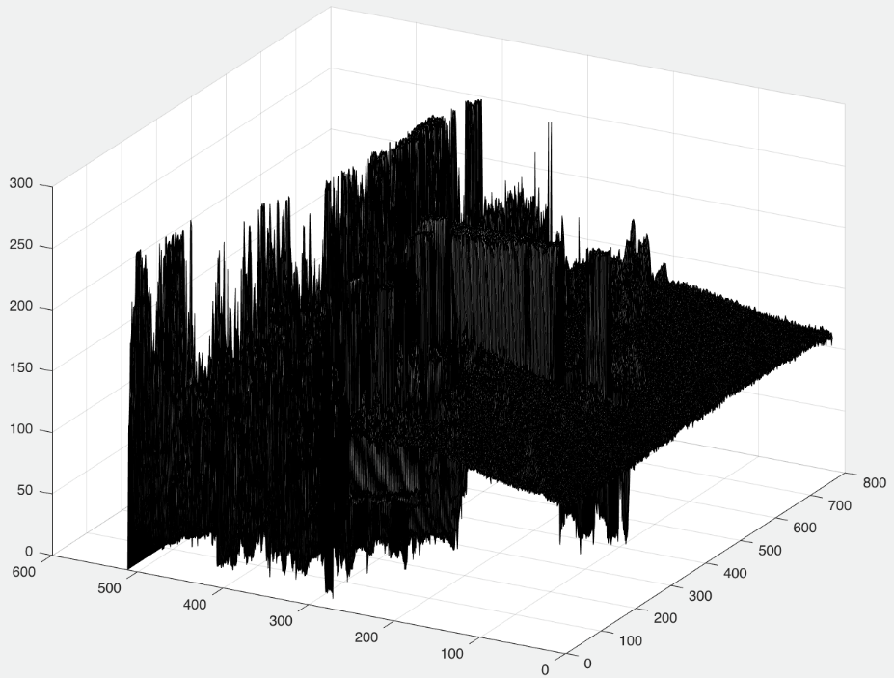
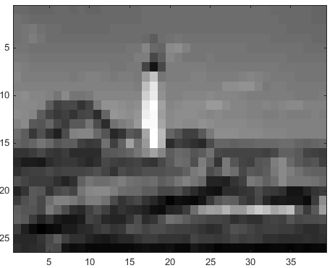
Representing an Image
Image: $y=f\left(i,j\right)$
$\left(i,j\right)$: pixel location
$f\left(i,j\right)$: intensity value at $\left(i,j\right)$
Notes:
Typically we like to think of an image as a function of two variables where at some location there is an intensity value and we represent this as a matrix
As we will see later, sometimes it is helpful to think about an image as a surface

Slide 7
Problem Formulation
$$y$$
A noisy image can be written as
$x$ is the clean image
$n\sim N(0,σ)$
Goal: estimate $x$ by denoising $y$ to obtain $\tilde{y}$
Notes:
Normally we have some image that was corrupted by noise but don’t know exactly what the noise is.
However, we usually assume the noise is Gaussian and model a noisy image as y = x + n

Slide 8
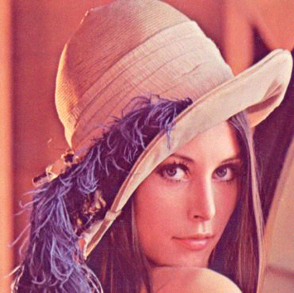
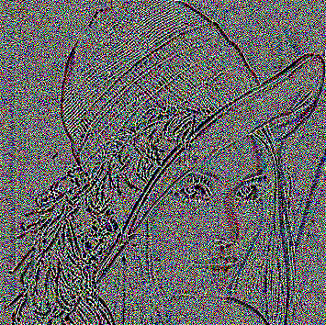
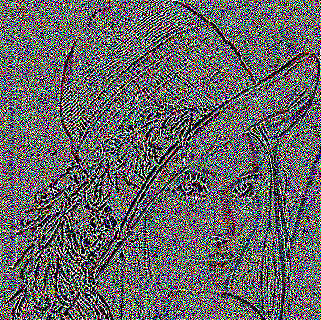
Research Question
Curvature Denoising Framework
1. Input: $y$
2. $κ\left(y\right)$
Can we outperform current patch based denoising methods by incorporating geometry into the denoising model?
3. $K_{den}$
4. Reconstructed Image, $\hat{y}$
Notes:
Question: Can we outperform current patch based denoising methods by incorporating geometry into the denoising model?
Consider the framework on the right – we will keep referring to this framework throughout the talk.
There is great potential for denoising with one geometry in particular - curvature information.
But we think we can do better by incorporating geometry into step 3 – specifically, the point of this particular work is
to decide whether the weights in our model should depend on
a. the similarity between image patches at pixels i and j
b. the similarity between curvature image patches at pixels i and j
c. the similarity between edge image patches at pixels i and j

Slide 9
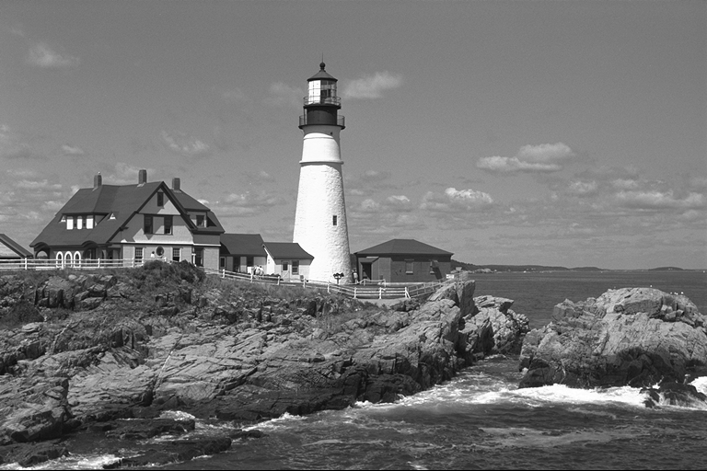
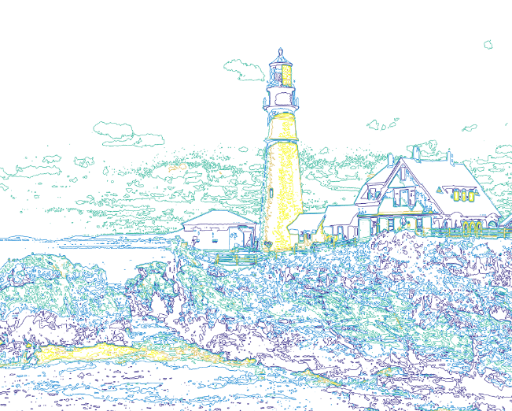
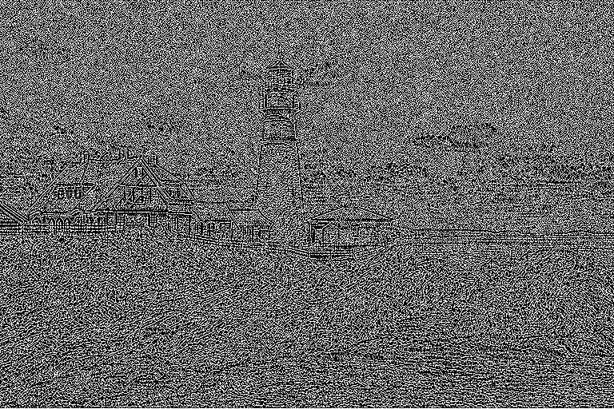
Why Image Curvature?
Motivation:
It was shown by Levine and Bertalmío that when an image is corrupted by noise, the curvature image is less effected by it
An image can be perfectly reconstructed from its level lines
Notes:
Before we can talk about the cuvature denoising framework, I need to tell you why we like curvature.
One of the reasons that we are considering curvature denoising is because the curvature image is
less effected by noise than the image itself
The other reason we are considering curvature is because a surface can be perfectly
reconstructed from its level sets and if we view an image as a surface we can imagine that it, too,
can be perfectly reconstructed
Bottom left – image viewed as a surface
Bottom middle – level sets of an image
Bottom right – curvature of the level sets of the iamge
Top right – original image

Slide 10
Curvature Denoising Framework
1. Input: $y=x+n$
2. $κ\left(y\right)$
3. $K_{den}$
4. Reconstructed Image, $\hat{y}$
Notes:
To summarize, we want to try to determine if there is a possibility for curvature denoising to do better than patch based natural image denoising.
Specifically with this work’s method of modifying how step 3 is calculated.
The basic idea is to consider a noisy image y
Denoise the curvature of the level lines, $k(y)$, to obtain $K_{den}$
Then reconstruct a clean image by Generating a new image whose level line curvature matches $K_{den}$ and level line contrast matches the noisy image $y$

Slide 11
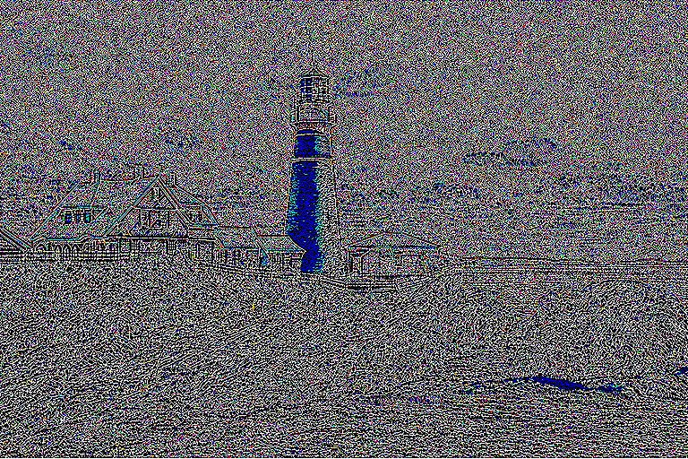
Step 2. Computing Image Curvature
Here we will consider the curvature of the level lines of an image $y$ as
$$k\left(y\right)=∇ ∙(\frac{∇y}{|∇y|})$$
Notes:
This definition of curvature is the one you typically see in a calc3 class
There are multiple methods for defining the curvature of an image, but we will consider this definition for the talk.
The fractional term is the unit normal vectors to the level lines of the image (the level lines are just pixels with the same intensity value)
When you take the gradient of this (which is really the divergence of the vector field of unit normals of the level lines) you get the change in the unit normal vectors or curvature
We approximate this with forward/backward or central differences. In practice we have found forward/backward differences to be most effective
These are examples of curvature images of lena and the lighthouse (respectively)

Slide 12
Step 4. Image Reconstruction
Given the denoised curvature $k_{den}$, one reconstruction equation is
$\hat{y}=\arg{\min_{y}} \int{|k\left(y\right) −k_{den}|}+ \frac{λ}{2}{\int{\left(y−x\right)}}^{2}$
$\int{|k\left(y\right) −k_{den}|}$ ensures that the the curvature of its level lines, $k\left(y\right)$, will approach that of the denoised curvature $k_{den}$
${\int{\left(y−x\right)}}^{2}$ ensures that the average intensity values of the level lines of $y$ are close to those of $x$
Notes:
Now that we’ve denoised the curvature image, how do we get back the original image?
(read slide – emphasize the basic idea with the two bullet points)

Slide 13
Step 3. Challenges with Denoising Image Curvature
The curvature of the level lines of an image is not a linear operator and therefore $k\left(y\right)≠k\left(x\right)+k\left(n\right)$
How do we accurately estimate the curvature image?
How do we denoise the curvature image well and preserve geometry of the curvature data?
How do we reconstruct the clean image effectively?
Notes:
One of the main challenges of denoising image curvature is that curvature is not a linear operation.
There are many other challenges with the Curavure Denoising Framework but the issue we are concerned
with in this talk is getting the best denoised curvature image possible
The rest of the talk is dedicated to exploring a way of adapting an existing algorithm to fit within the curvature denoising framework
And attempting to exploit self similarity within different representations of the data for getting an optimal denoised result in step 3 of the framework

Slide 14
Curvature Denoising Framework
1. Input: $y$
2. $κ\left(y\right)$
3. $K_{den}$
4. Reconstructed Image, $\hat{y}$
Notes:
To reiterate, we are focusing on step 3. How can we get the best curvature image – preserving intensity and geometry?

Slide 15
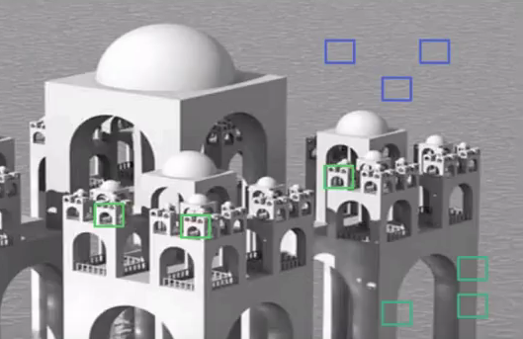
NLM Image Denoising
$$w\left(i,j\right)$$
$$w\left(i,j\right)$$
$$w\left(i,j\right)$$
Approach: Non-local Means (NLM)
$$NLM\left[\hat{y}\right]\left(i\right)=\sum_{j ∈ I}{ω\left(y\left(i\right),y\left(j\right)\right)y\left(j\right)}$$
where the set of weights $\{ω{\left(y(i),y(j)\right)\}}_{j}$ depend on the similarity between image patches located at pixels $i$ and $j$ with $0≤ω\left(y(i),y(j)\right)≤1$ and $\sum_{j ∈ I}{ω\left(y(i),y(j)\right)=1}$.
Notes:
Explain the brief idea of what NLM is

Slide 16
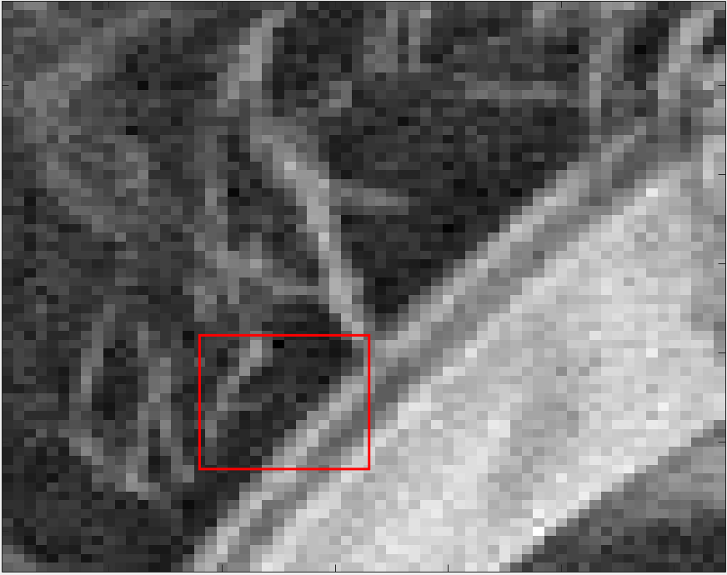
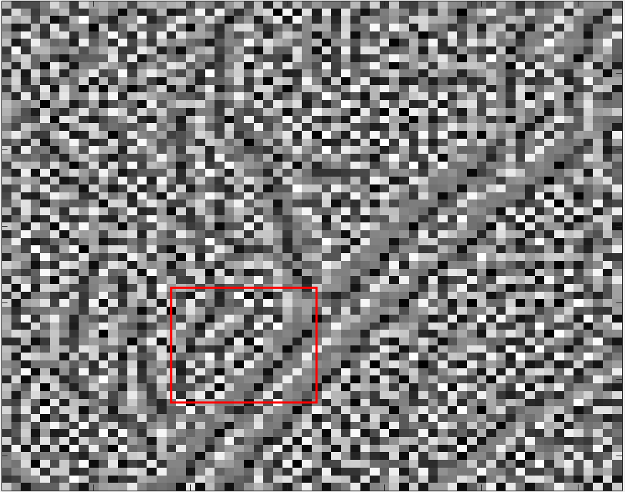
NLM for Curvature Information
$$y$$
$$NLM\left[κ(\hat{y})\right]\left(i\right)=w_{i,j}κ\left(y\left(j\right)\right)$$
where the weights, $w_{i,j}$ are computed from
Natural image data: $y$
Curvature data: $κ\left(y\right)$
Edge data: $e\left(y\right)=\frac{∇y}{\left|∇y\right|}$
$$κ\left(y\right)$$
Notes:
This is how we adapt NLM for considering curvature image data.
The images on the right have regions highlighted in red which represent the example we will walk through
We generated this data by taking a clean lena image as seen on slide 8
To generate the images seen here, I took the lena image that is assumed to be clean and added sigma = 15 random Gaussian noise to the image. I then extracted this small subset of the image and highlighted a single region of interest. On the next slide you will see this region of interest in each of these three representations

Slide 17
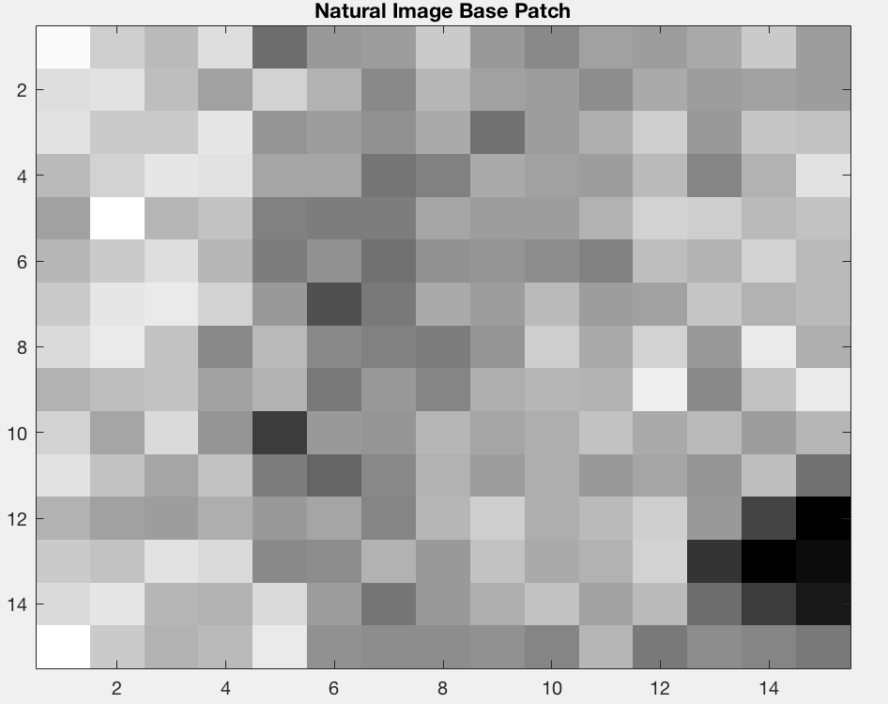
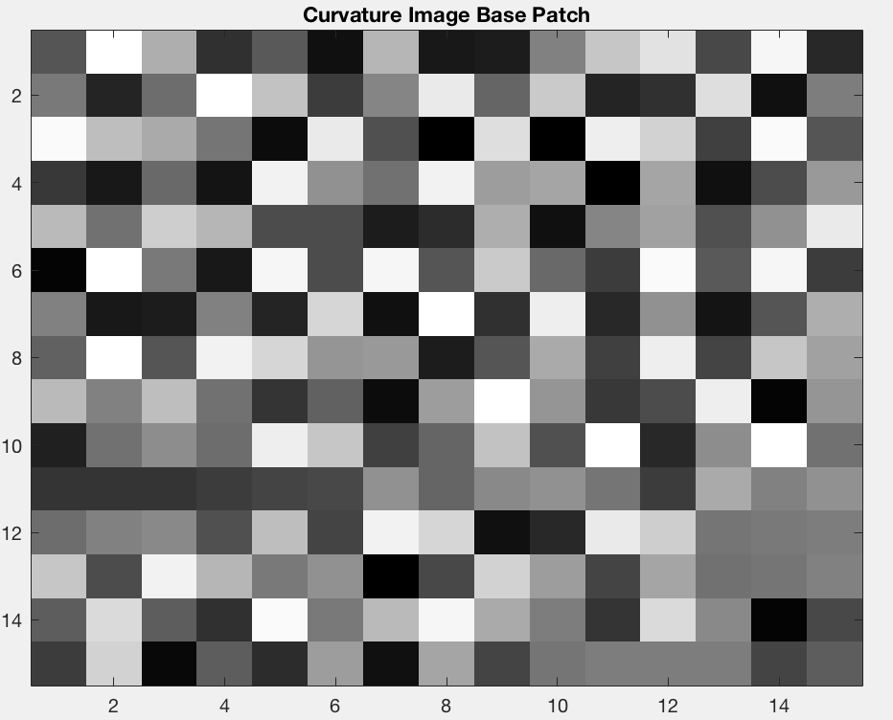
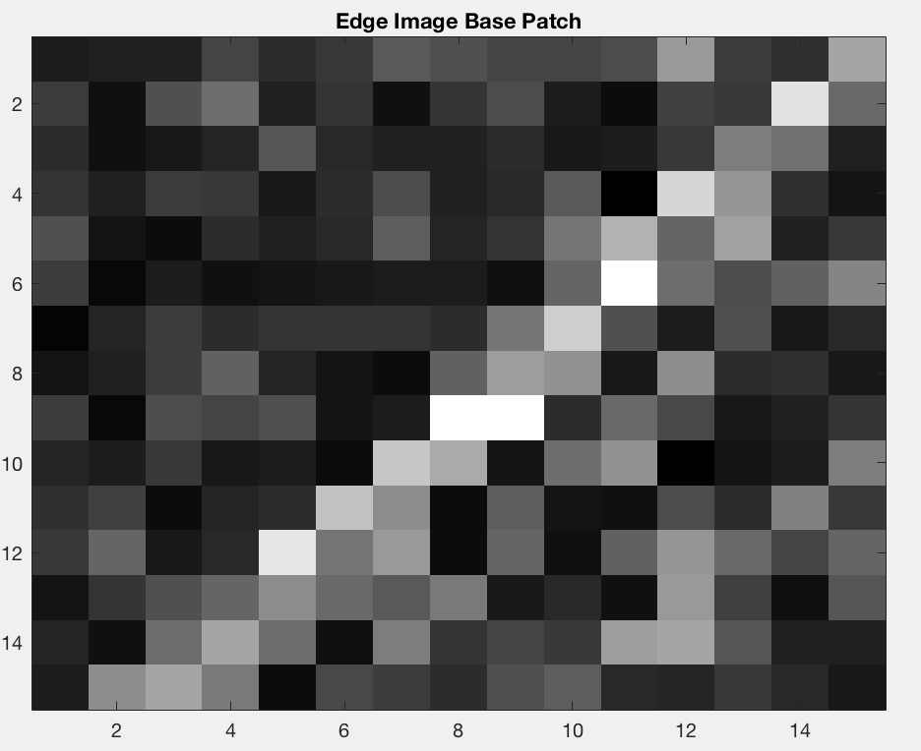
NLM Example: “Base Patches”
$$y$$
$$κ\left(y\right)$$
$$e\left(y\right)$$
Notes:
These are the “base” patches we are trying to denoise (as highlighted in the previous images)

Slide 18
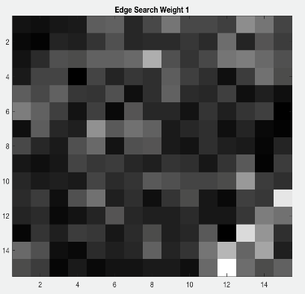
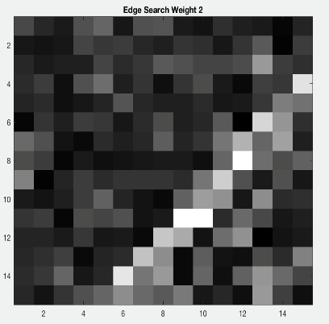
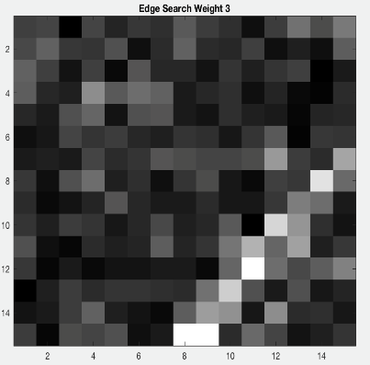
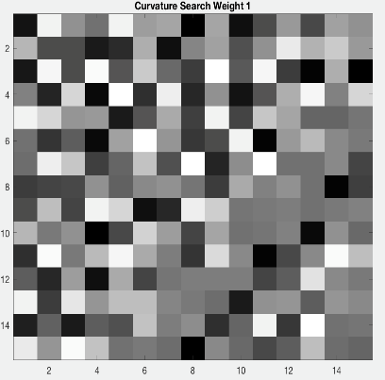
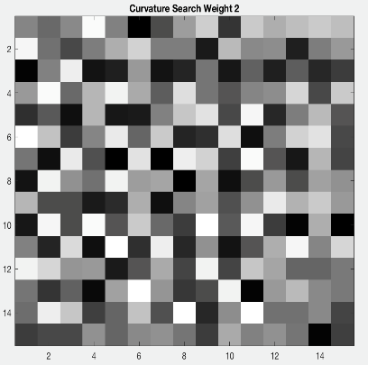
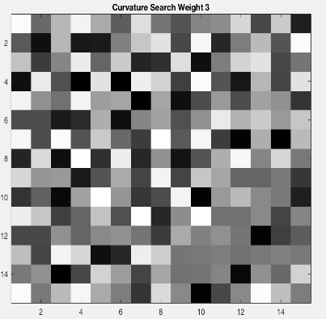
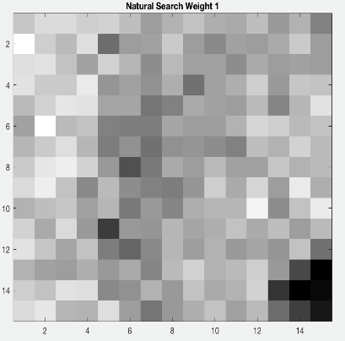
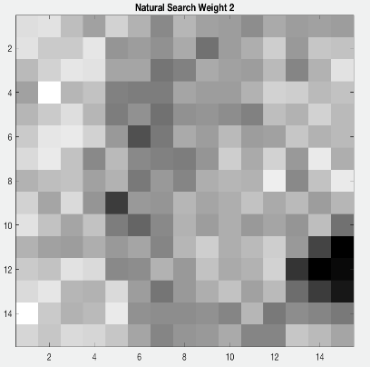
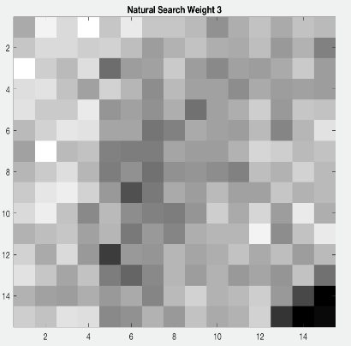
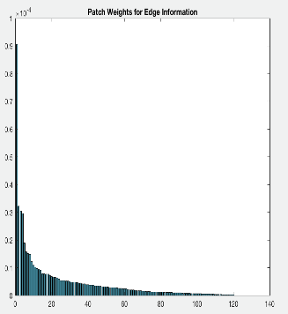
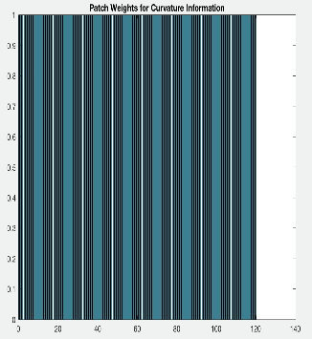
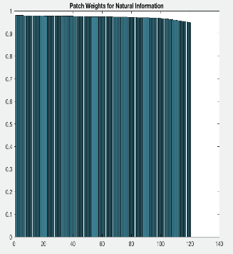
Match 1
Match 2
Match 3
$$e\left(y\right)$$
$$κ\left(y\right)$$
$$y$$
Notes:
Explain how we generate this data and what this picture means and then parlay into the graph plots which show some strange facts
This data represents the “search” patches that were given the highest similarity score for each representation
Match1 = highest
Match2 = second highest
Match3 = third highest
.. Similarity score

Slide 19
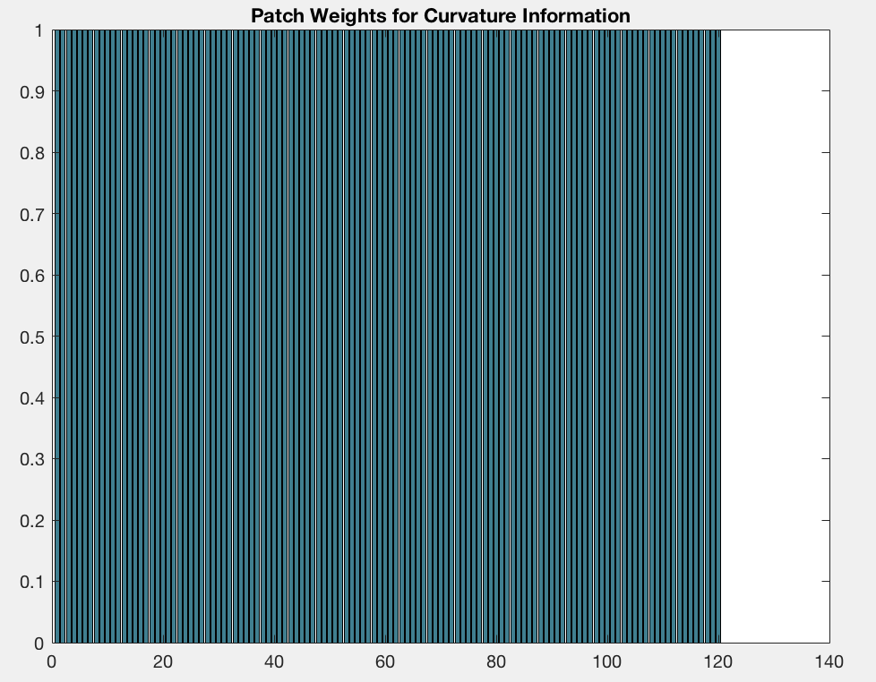
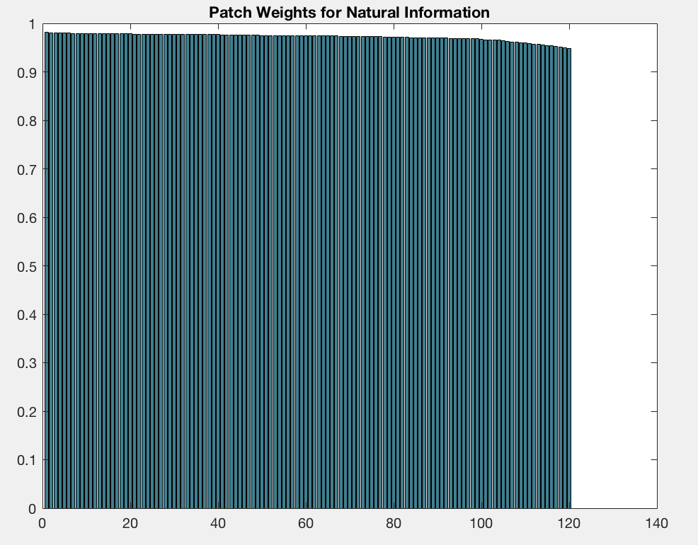
Similarity Score vs Patch Index
Notes:
represent how much self-similarity there is in each representation of data – its weird that edge data does not have as much information as natural or curvature data

Slide 20
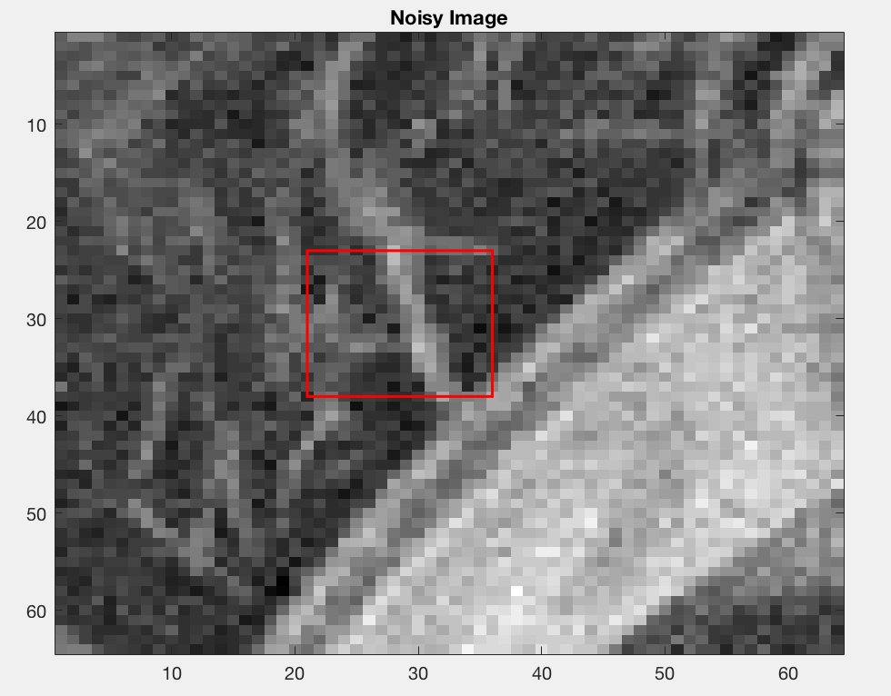
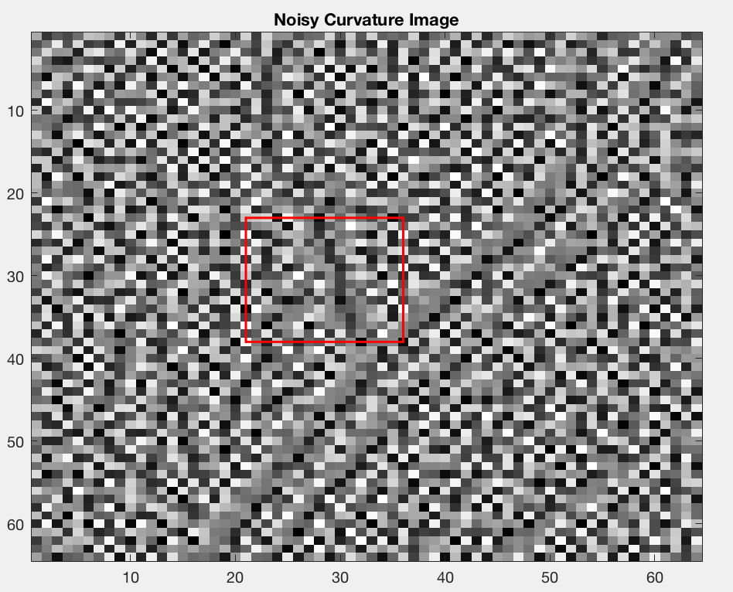
NLM Example 2: Edge Data Only
Notes:
These are the “base” patches we are trying to denoise (as highlighted in the previous images)

Slide 21
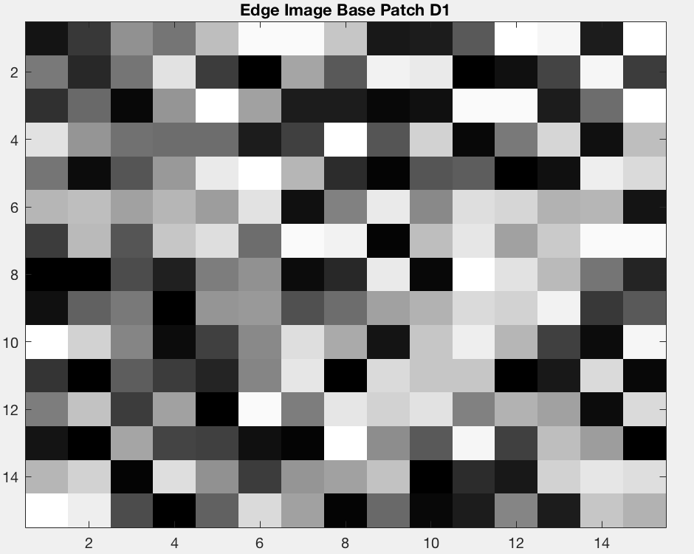
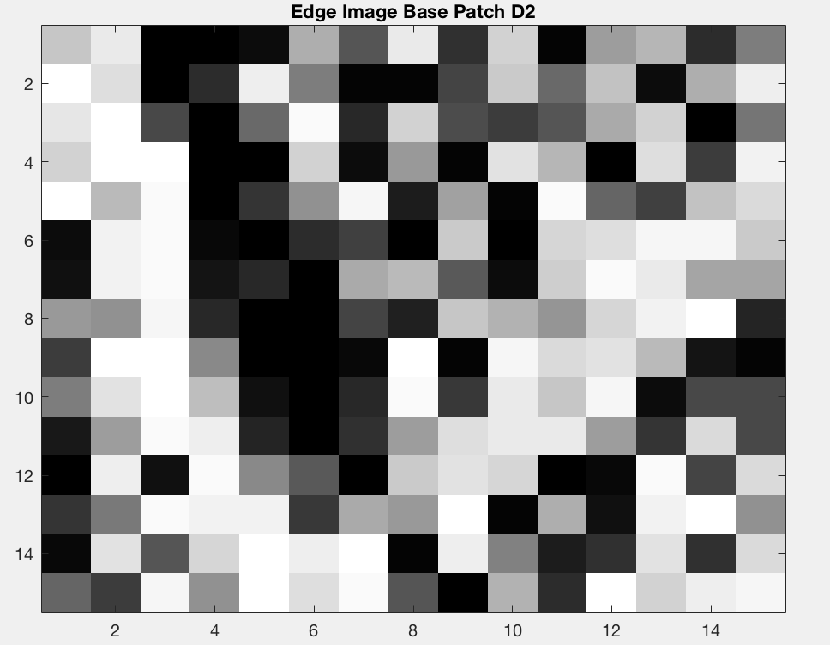
Notes:
These are the “base” patches we are trying to denoise (as highlighted in the previous images)

Slide 22
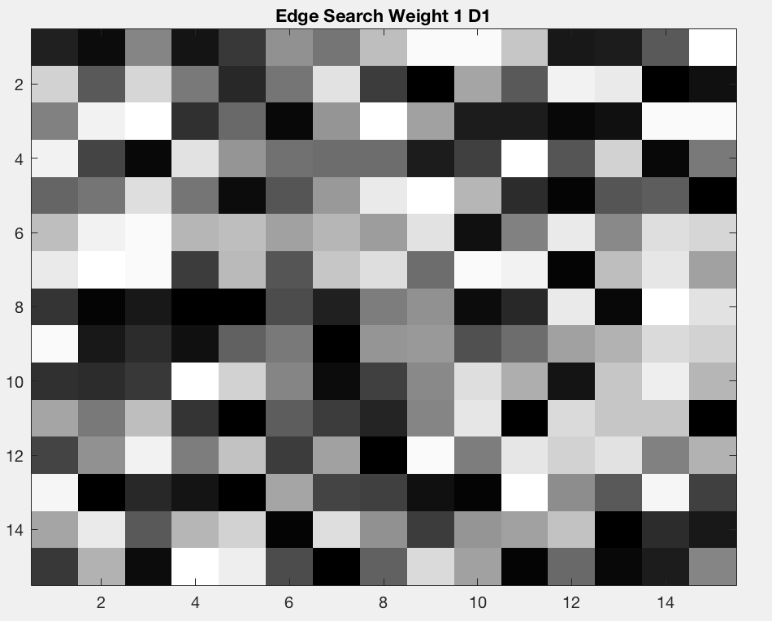
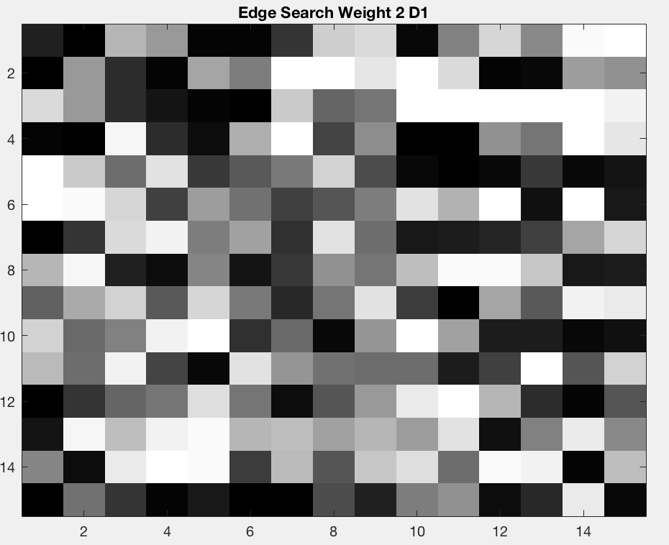
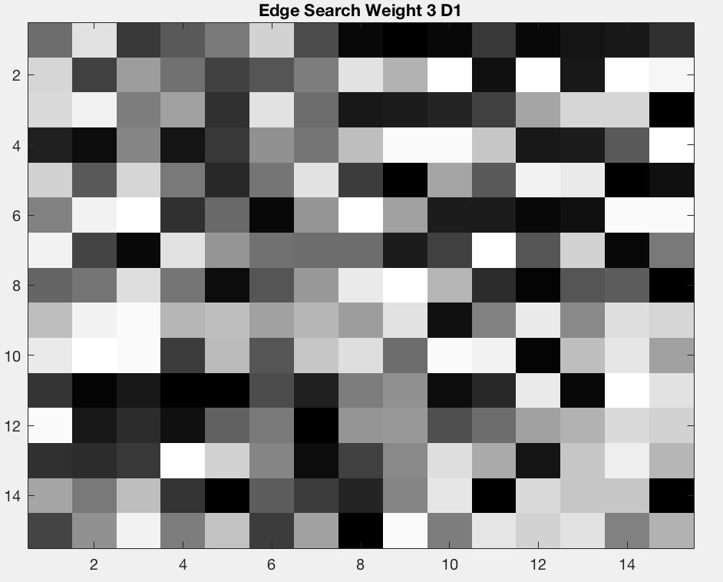
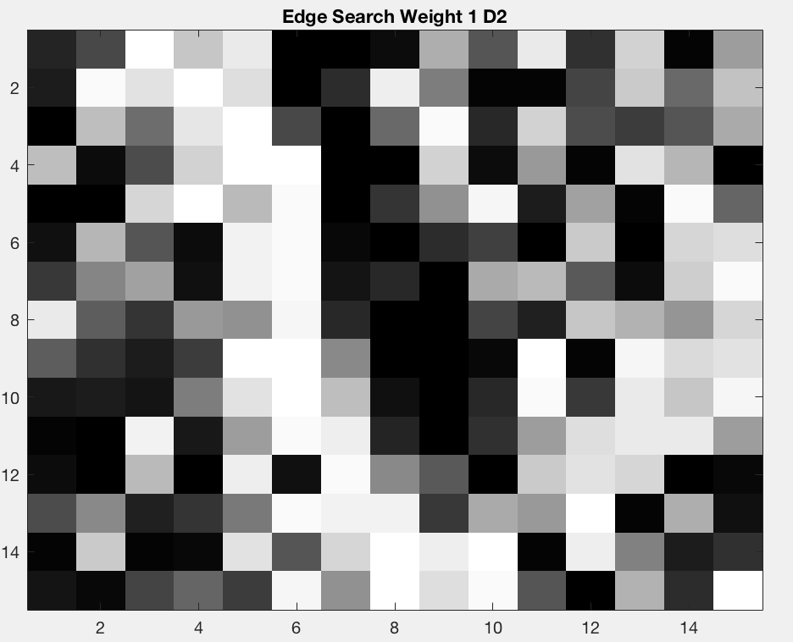
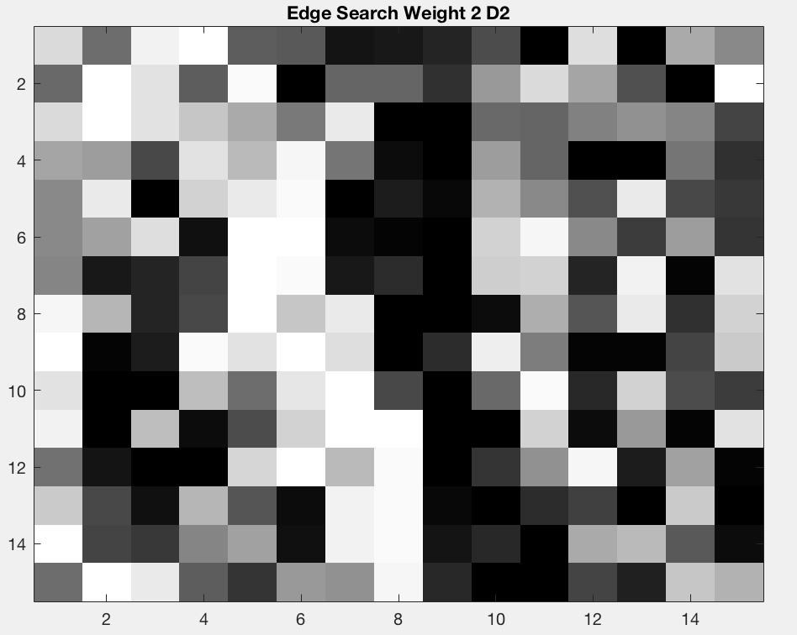
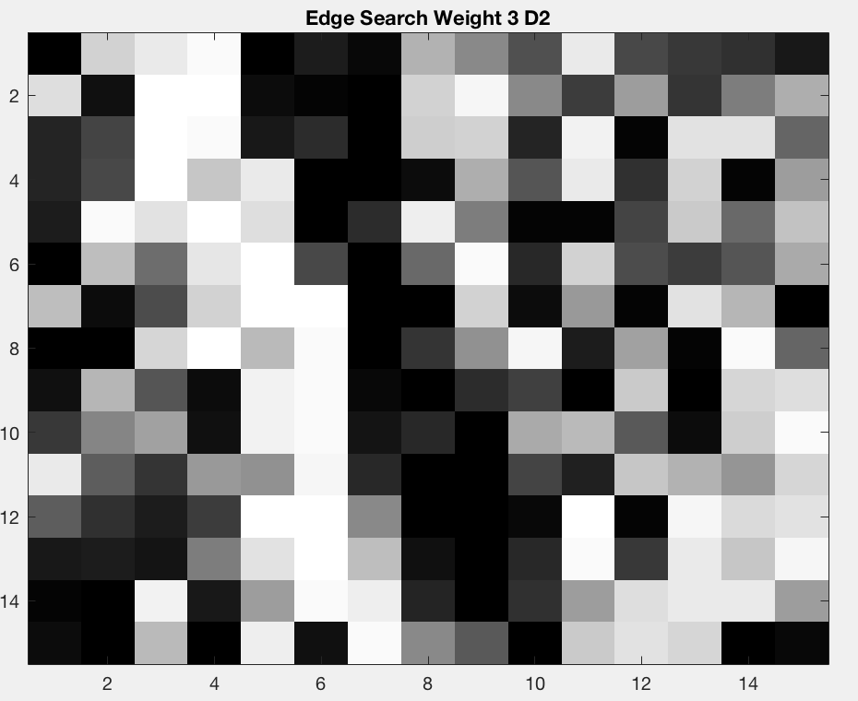
Notes:
These are the “base” patches we are trying to denoise (as highlighted in the previous images)

Slide 23
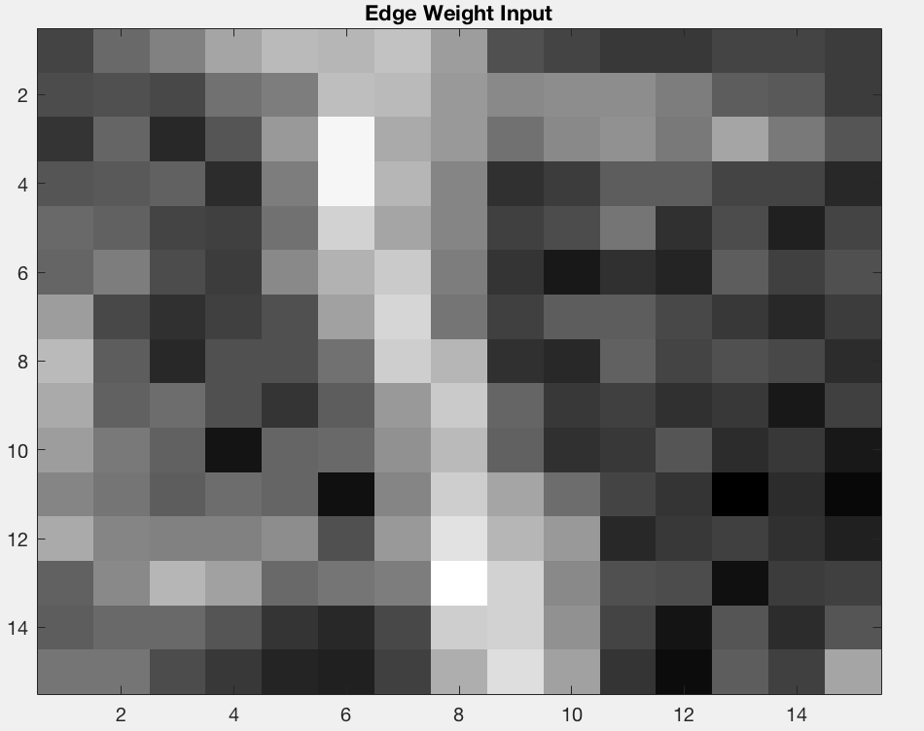
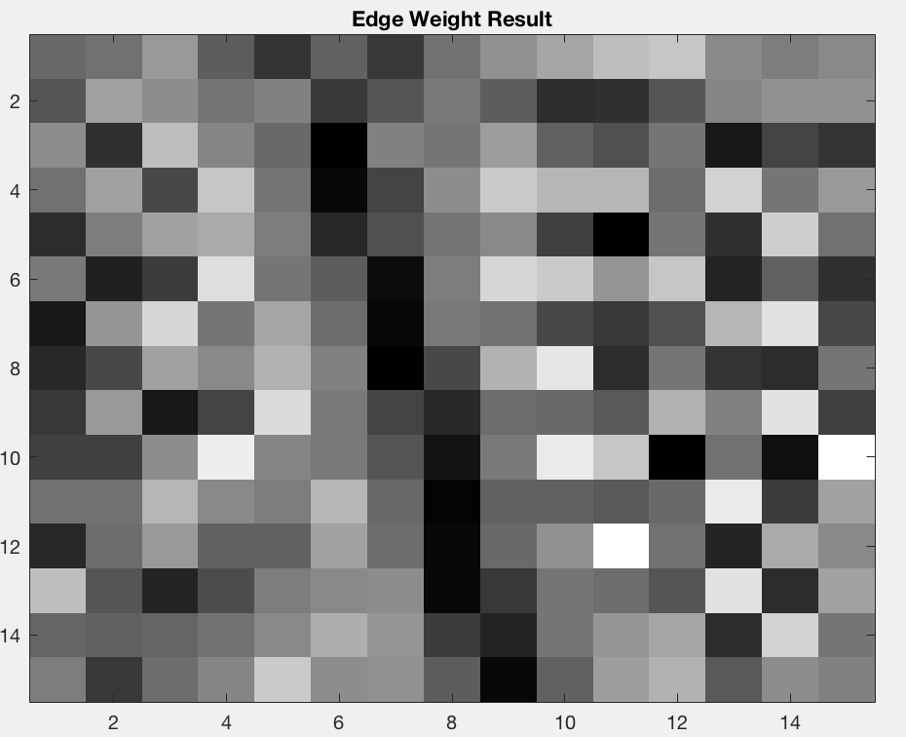
Notes:
The bottom image has more information within the lower left corner of the square you see on the left

Slide 24
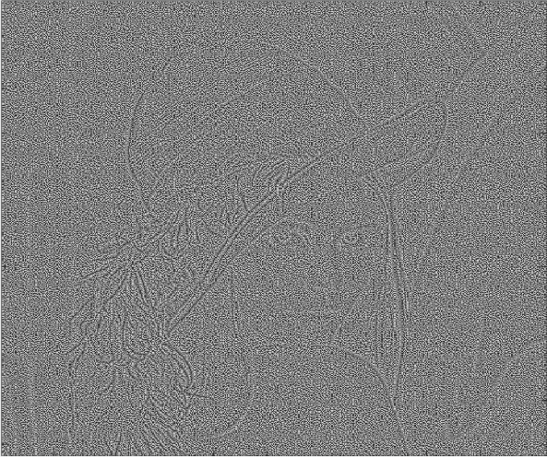
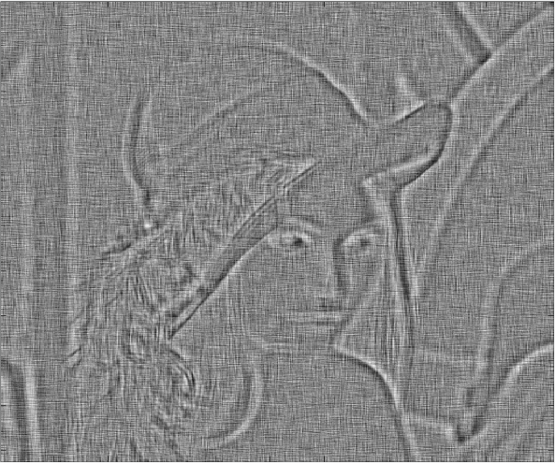
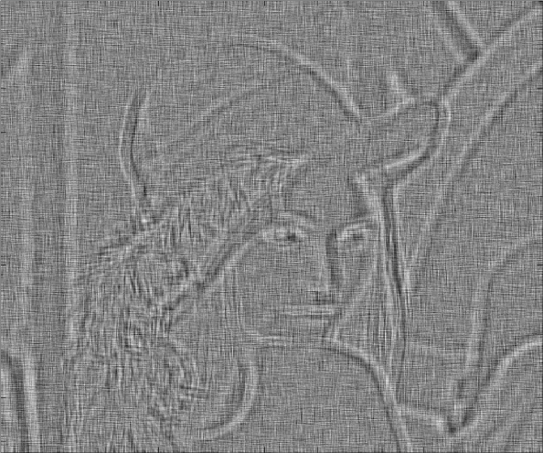
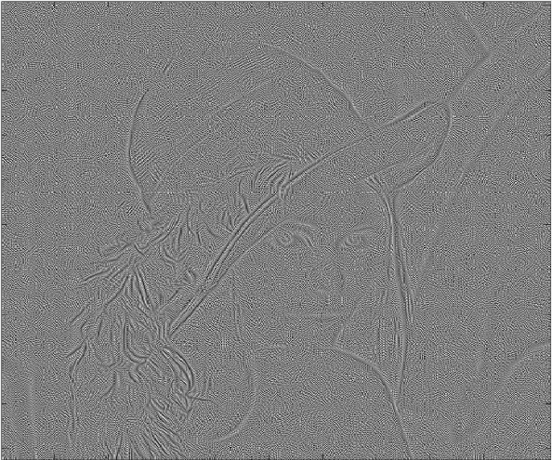
Results
1.
$$ω_{i,j}=ω\left(y(i),y(j)\right)$$
2.
$$ω_{i,j}=ω\left(κ(y\left(i\right)),κ(y\left(j\right))\right)$$
3.
$$ω_{i,j}=ω\left(e(y\left(i\right)),e(y\left(j\right))\right)$$
Input
Output
Results with each representation. Top Row, Noisy Curvature Image, $σ$=15. Bottom Row, Denoised Result.
Notes:
Ultimately, our results demonstrate that a balance between self-similarity and geometry should result in the most effective denoising method.

Slide 25
Future Work
While the edge based weights are promising with respect to preserving geometry, none of the three representations for self-similarity preserved contrast. Therefore more analysis needs to be performed to understand how self-similarity is effecting the quality of the denoised curvature result.
Additionally, it is possible that an optimal mechanism for measuring self-similarity used to compute the weights $ω\left(y(i),y(j)\right)$ has yet to be considered. In the future, we plan to investigate other representations of image data aside from edge information, curvature information, and natural image information.
Ultimately, our results demonstrate that a balance between self-similarity and geometry should result in the most effective denoising method.

Slide 26
References
M. Bertalmío and S. Levine, “Denoising an Image by Denoising Its Curvature Image”, SIAM J. Imaging Sciences, Vol. 7, pp. 187-211 (2014).
A. Buades, B. Coll, JM. Morel, “A Non-local Algorithm for Image Denoising”, Proceedings of the IEEE Computer Society Conference on Computer Vision and Pattern Recognition, Vol. 2, pp. 60-65 (2005).
M. Lebrun, “An Analysis and Implementation of the BM3D Image Denoising Method,” Image Processing On Line, pp. 175–213 (2012). https://doi.org/10.5201/ipol.2012.l-bm3d
Notes:
Thank you everyone for being attentive
And thank you to my research advisor Dr. stacey levine and donovan ramsey for helpful discussions
feel free to ask any questions

